Slide 1
N-Queen’s problem

Slide 2
Problem Definition
N - Queens problem is to place n - queens in such a manner on an n x n chessboard that no queens attack each other by being in the same row, column or diagonal.
It can be seen that for n =1, the problem has a trivial solution, and no solution exists for n =2 and n =3. So n>=4 queens problem.

Slide 3
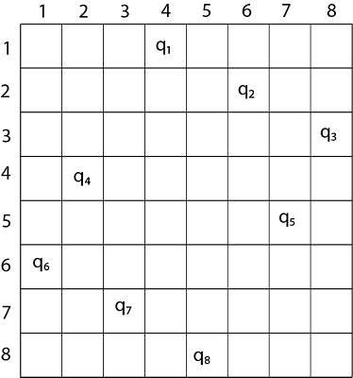
8-Queen’s problem (one possible solution) Note: There are 92 possible distinct solution for 8-Queen’s problem

Slide 4
Explanation
Thus, the solution for 8 -queen problem for (4, 6, 8, 2, 7, 1, 3, 5).
If two queens are placed at position (i, j) and (k, l).
Then they are on same diagonal only if (i - j) = k - l or i + j = k + l.
The first equation implies that j - l = i - k.
The second equation implies that j - l = k - i.
Therefore, two queens lie on the duplicate diagonal if and only if |j-l|=|i-k|

Slide 5
Pseudo code
void queen(int n) {
int k=1;
a[k]=0;
while(k!=0) {
a[k]=a[k]+1;
while((a[k]<=n)&&!place(k))
a[k]++;
if(a[k]<=n) {
if(k==n)
print_sol(n);
else {
k++;
a[k]=0;}
}
else
k--;}}

Slide 6
Pseudo code
int place(int pos) {
int i;
for (i=1;i<pos;i++) {
if((a[i]==a[pos])||((abs(a[i]-a[pos])==abs(i-pos))))
return 0;
}
return 1;
}
void print_sol(int n) {
int i,j;
count++;
printf("\n\nSolution #%d:\n",count);
for (i=1;i<=n;i++) {
for (j=1;j<=n;j++) {
if(a[i]==j)
printf("Q\t");
else
printf("*\t");
}
printf("\n");
}
}

